Slide 1








Kế hoạch Phát triển
Ứng dụng Quản lý Dự án Flutter
Tương tự monday.com - Tối ưu cho Mobile
16 tuần
3 developers
$15K-25K
Manus AI - Project Planning & Architecture Design
Ngày: 18/06/2025

Slide 2









Tổng quan Dự án
Mục tiêu
16
3
Ứng dụng quản lý dự án mobile-first
Tuần
Developers
Trải nghiệm người dùng mượt mà
Cộng tác nhóm real-time
Kiến trúc có thể mở rộng
Ngân sách
Development
$34,000
Infrastructure
$5,400
Platform
Other costs
$2,700
Total
$42,100
iOS
Android
Flutter

Slide 3












Phân tích Thị trường
Competitive Advantage
Monday.com - Top 10 Features
Mobile-first Design
Customizable Dashboards
Flutter Performance
Vietnamese Localization
Visual Project Tracking
Cost-effective Solution
Automation
Market Opportunity
Collaboration Tools
📈
📱
Time Tracking
Growing Remote Work
Mobile-first Trend
🇻🇳
💡
200+ Integrations
Vietnamese Market
SME Focus

Slide 4







Tính năng Cốt lõi
Authentication
Project Management
Task Management
• Đăng ký/Đăng nhập
• Create/Edit/Delete
• Kanban board
• Profile management
• Project overview
• Drag & drop
• Team invitation
• Search & filter
• Task details
• Role management
• Team members
• Priority levels
Collaboration
Dashboard
Future Features
• Real-time comments
• Project overview
• Time tracking
• @Mentions
• Task statistics
• Gantt charts
• File attachments
MVP Strategy
• Progress tracking
• Custom fields
• Activity feed
• Recent activities
• Integrations
Tập trung vào 5 tính năng cốt lõi để đảm bảo chất lượng và trải nghiệm người dùng tốt nhất

Slide 5

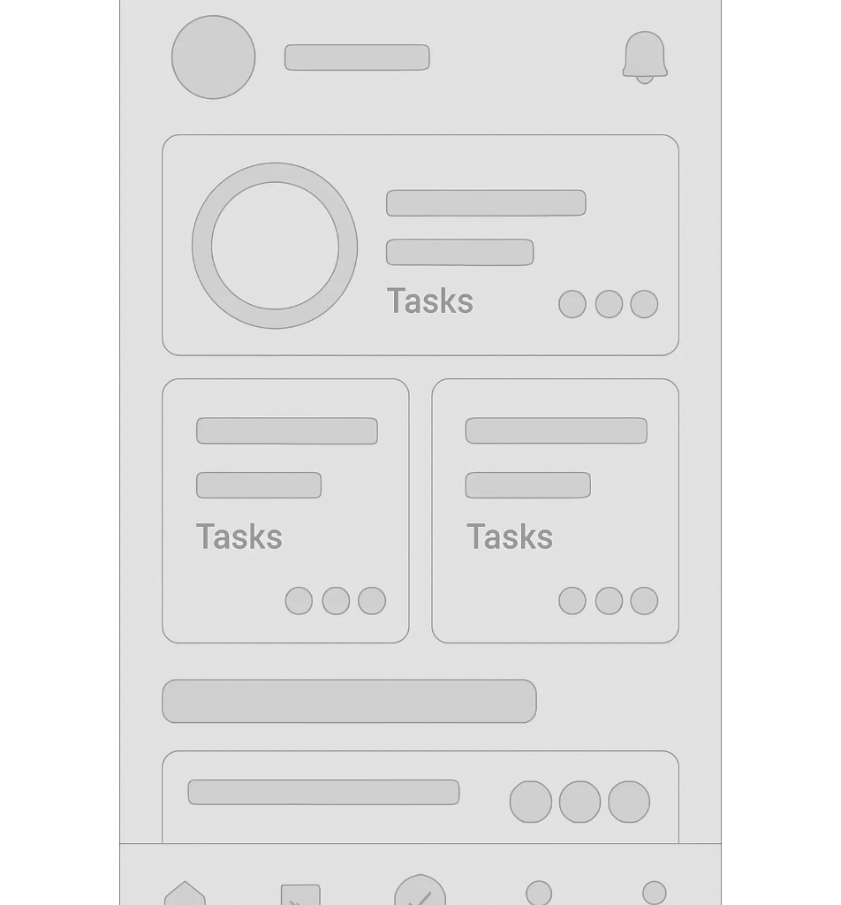
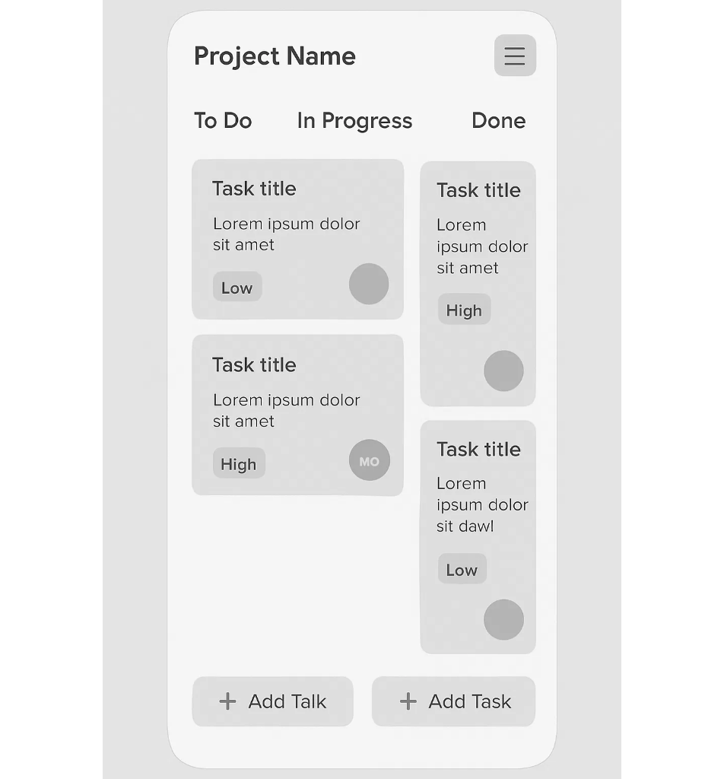
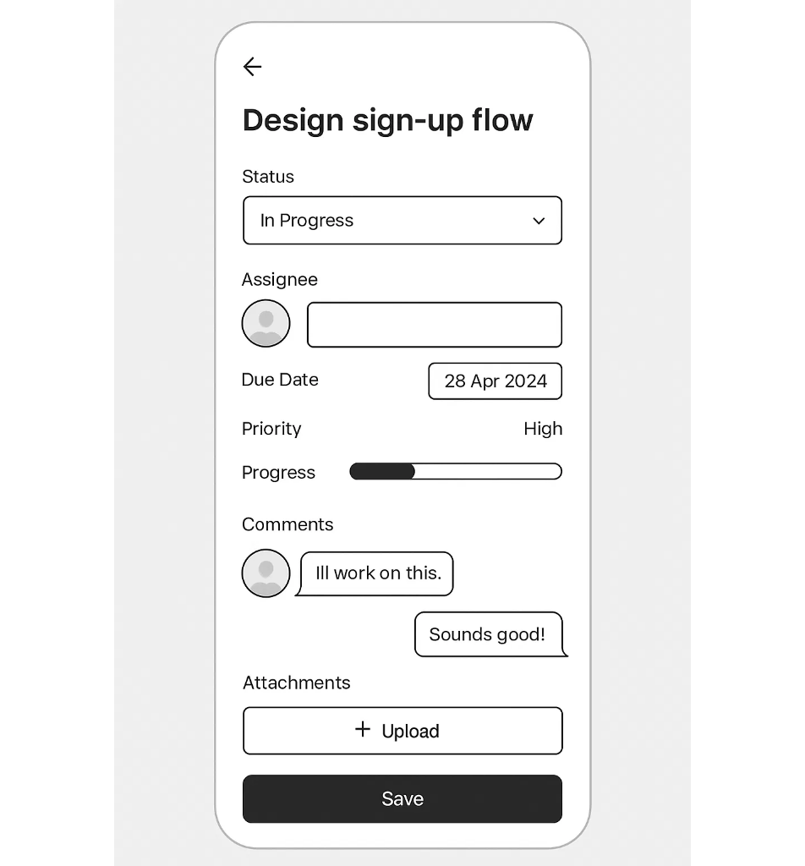




Thiết kế UI/UX
Design System
Dashboard
Kanban Board
Task Detail
Colors
Typography
Roboto Bold
Roboto Medium
Roboto Regular
Spacing
4dp • 8dp • 16dp • 24dp • 32dp
Border Radius: 8dp
Touch Target: 44dp min
Design Principles
Mobile-First
Intuitive
Consistent
Accessible
Tối ưu cho mobile
Dễ hiểu và sử dụng
Nhất quán toàn bộ app
Hỗ trợ accessibility

Slide 6














Kiến trúc Kỹ thuật
Frontend
• Flutter 3.24.5
Backend
• Dart 3.5.4
• FastAPI (Python)
• Riverpod (State)
• PostgreSQL
• Go Router (Navigation)
• JWT Authentication
• Material Design 3
• RESTful API
• WebSocket (Real-time)
Clean Architecture
Technology Stack
Presentation Layer
Flutter
FastAPI
Pages, Providers, Widgets
Riverpod
PostgreSQL
Hive
AWS/GCP
Domain Layer
Dio
JWT Auth
Entities, Use Cases, Repositories
Data Layer
Models, Data Sources, APIs
Key Benefits
Performance
Scalable
Cross-platform
Maintainable
Flutter native performance
Clean Architecture
iOS & Android
Modular structure

Slide 7





Timeline Phát triển
16 tuần - 5 phases chính
Phase 1: Foundation Setup
Environment & Infrastructure
Tuần 1-2
• Flutter project setup
• Backend API setup
• Clean Architecture
• Authentication system
Phase 2: Core Features
Auth, Projects, Tasks
Tuần 3-8
• User management
• Task management
• Project CRUD
• Basic UI components
Phase 3: Advanced Task Management
Kanban & Collaboration
Tuần 9-12
• Kanban board
• Real-time comments
• Drag & drop
• File attachments
Phase 4: Dashboard & Analytics
Analytics & Reporting
Tuần 13-14
• Project overview
• Progress tracking
• Task statistics
• Search & filter
Phase 5: Polish & Deployment
Testing & Launch
Tuần 15-16
• UI/UX polish
• Testing & QA
• Performance optimization
• App store deployment

Slide 8
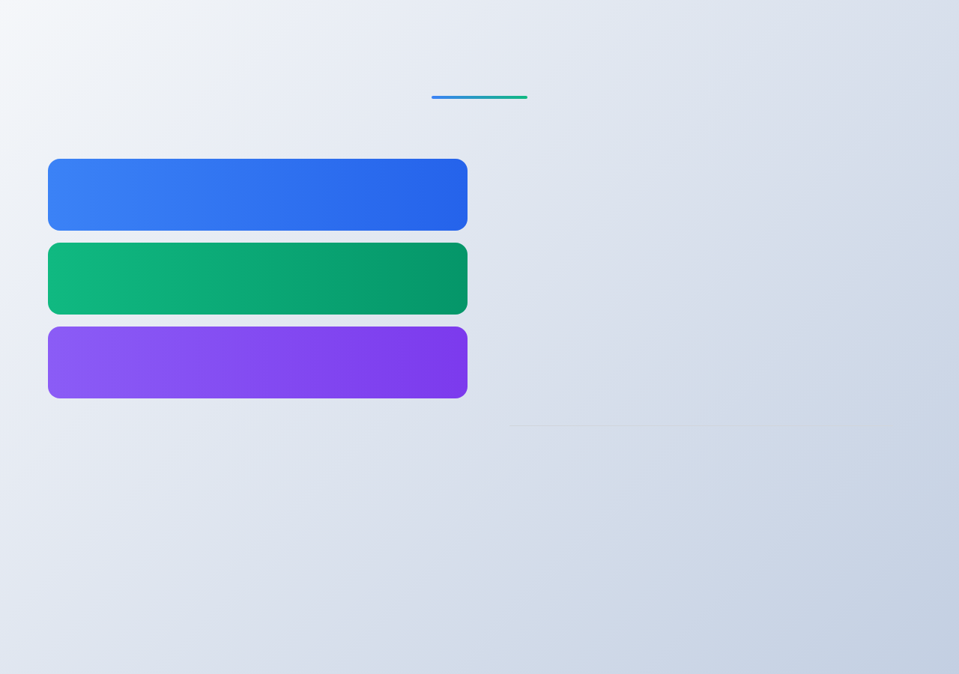
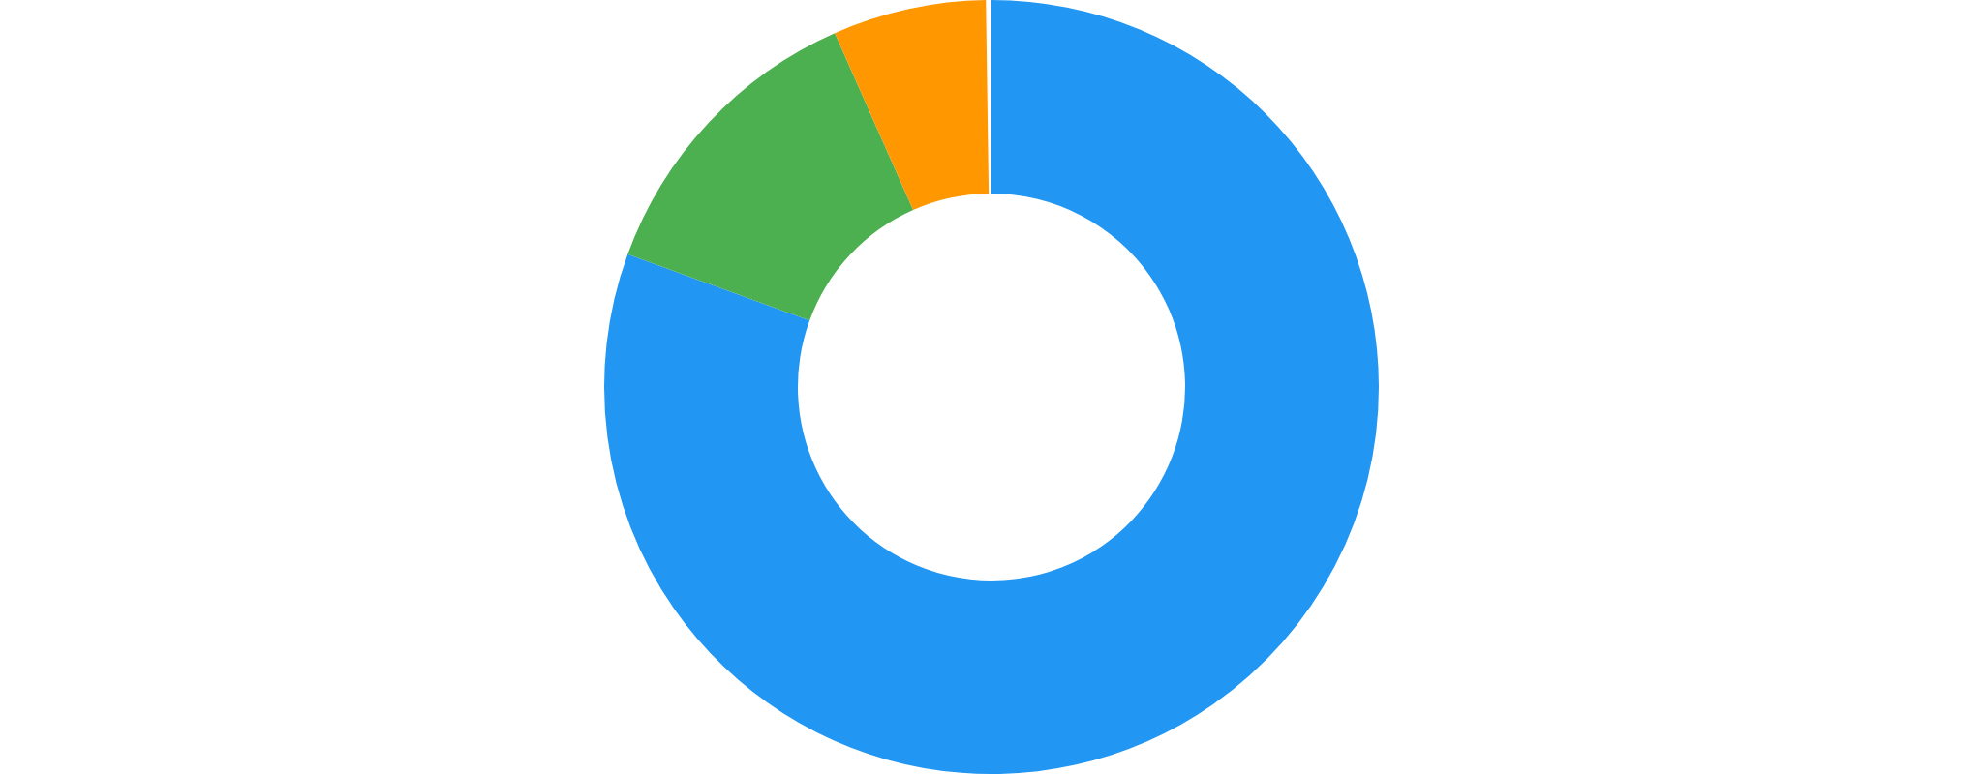





Nhóm phát triển & Ngân sách
Team Structure
Budget Breakdown
Flutter Developer (Senior)
Frontend development, UI implementation
3+ years Flutter experience
Backend Developer (Mid-Senior)
API development, database, deployment
3+ years Python/FastAPI experience
UI/UX Designer (Part-time)
Development
$34,000
Design system, wireframes, user testing
Mobile app design experience
Infrastructure
$5,400
Other costs
$2,700
Total Budget
$42,100
Cost Optimization Options
Junior Developers
Self-hosted
Minimal Services
Save $8,000
Save $3,000
Save $500
Optimized Total: $30,600

Slide 9










Quản lý Rủi ro
Technical Risks
Project Risks
Flutter Performance
Scope Creep
Low-end devices compatibility
Feature requests beyond MVP
Medium
Mitigation: Early testing, optimization
High
Mitigation: Clear requirements, change process
Real-time Features
Timeline Delays
WebSocket implementation complexity
Development behind schedule
Medium
Mitigation: Prototype early, fallback options
Medium
Mitigation: Buffer time, agile approach
File Storage Costs
Team Availability
Unexpected storage expenses
Key team member unavailability
Low
Mitigation: Size limits, monitoring
Medium
Mitigation: Cross-training, documentation
Risk Mitigation Strategy
Early Detection
Prevention
Mitigation
Adaptation
Regular monitoring & reviews
Best practices & planning
Backup plans & alternatives
Agile response to changes

Slide 10





Success Metrics & KPIs
Technical KPIs
Business KPIs
UX KPIs
Launch time:
< 3s
Downloads (Month 1):
1,000+
Task completion:
> 90%
API response:
< 2s
DAU (Month 3):
500+
User error rate:
< 5%
Crash rate:
< 1%
Retention (30d):
60%
Session duration:
> 5min
Test coverage:
> 80%
App Store rating:
> 4.0
NPS Score:
> 50
Uptime:
> 99.5%
Feature adoption:
70%
Satisfaction:
> 4.2/5
Long-term Roadmap
1
2
3
Ready to Start
Year 1
Year 2
Year 3
16 weeks to MVP
• Advanced reporting
• Web application
• AI recommendations
Strong ROI potential
• Time tracking
• Desktop apps
• Voice commands
Scalable architecture
• Gantt charts
• Project templates
• AR/VR collaboration
• Custom fields
• Enterprise features
• Advanced automation

